Slide 1
Surgical tool tracking with RFID
With RFID technology Stallion supports
the improvement of safety and efficiency during surgery

Slide 2
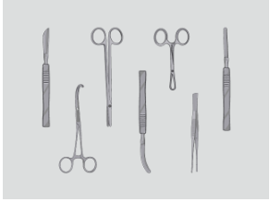
US regulations require a UDI (Unique Device Identifier)* be placed on each surgical tool by 2020. Europe follows this movement and plans to complete by 2027.
Additionally, the set up of surgical tools is time consuming even by highly skilled and experienced operators. How to make the process more efficient is a big challenge.
* UDI(Unique Device Identification) regulation
The rule of a product identification that should be applied to all medical devices for the safe use and storage

Slide 3
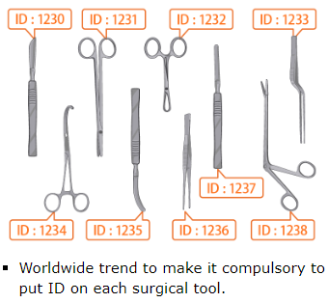
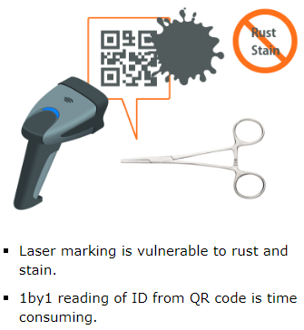
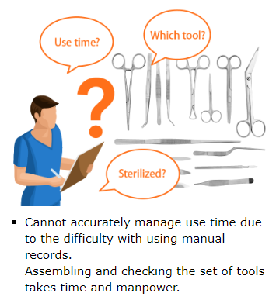
Challenges in surgical tool market

Slide 4
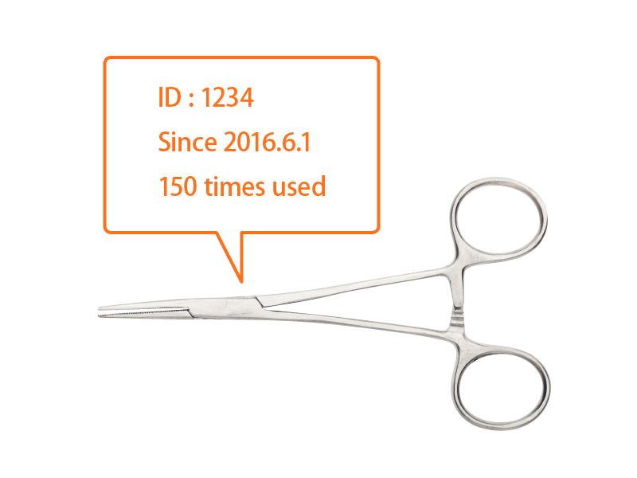
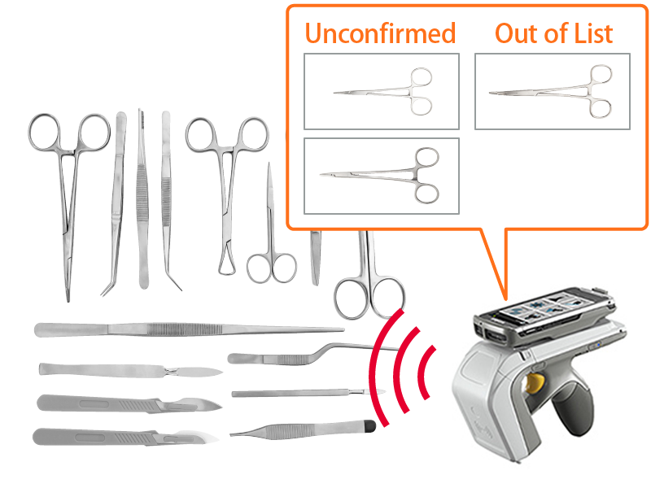
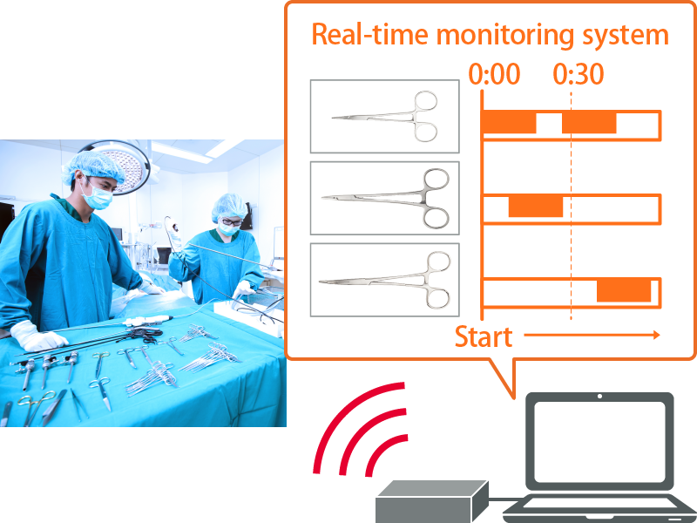
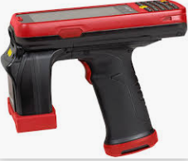
Advantages of RFID
RFID tag as unique ID.
Record of use time and life time, makes management easier.
Quick and batch reading with RFID enables operators to efficiently assemble and check the set of tools.* RFID Reader in above image. Alien ALR SH350 Terminal
Measuring the times of use for each tool to reduce excessive amount of stock.
Recording the order of the use to optimize the preparation of tools before surgery.

Slide 5
Why RFID
Efficient Inventory count and time usage management.
Reading in batches for quick management.
Reading is possible even when covered with blood after surgery.
Why Murata
RFID tag for on-metal application is available.
Robust RFID tag that can survive auto-clave process is available.
Murata can offer support on the reading environment and how/where to attach the tag with in-depth knowledge on RF technology.

Slide 6
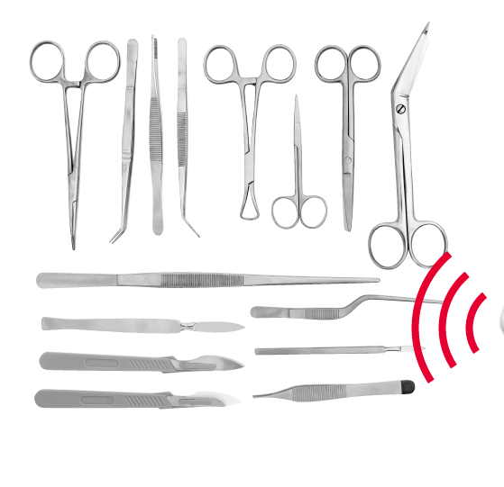
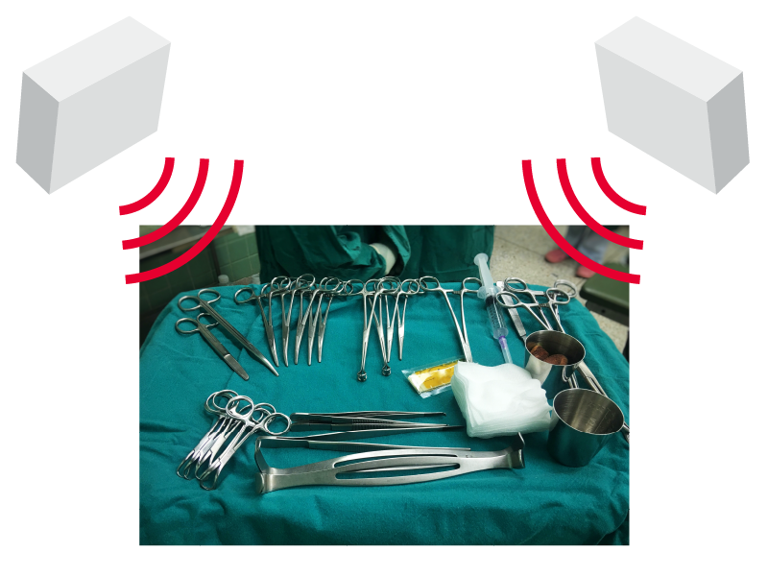

Reading method
Scanning with hand-held reader Reader.
Set reader and antennas to read tags without manual operation.

Slide 7
How to attach
Surface Preparation :
When mounting a RFID tag to any asset, the success of the application depends not only on the strength of the epoxy or adhesive, but also on how well the adhesive adheres to the surface to which it being applied. The strength of the bond relies on the epoxy’s ability to mechanically attach into the surface.
Clean – bonding surfaces must be free of any contaminants such as grease, oil, and wax, that might have built up from regular use. Clean contaminated surfaces with lacquer thinner, acetone, or isopropyl rubbing alcohol, whichever is most appropriate to the surface. Wipe with a dry towel before the solvent dries. Follow all safety precautions when working with solvents.
Dry – all bonding surfaces must be as dry as possible for good adhesion. Allow several minutes for drying, and if necessary, accelerate drying by warming the surface with a hair dryer or heat lamp. When working outdoors, watch for condensation that could affect the bonding process.
Attach Tag – apply tag to the surface. Firmly press down for several seconds to ensure the bonding surface is completely contacting the tag. Be advised of the recommend curing time of the adhesive or epoxy, ranging from a couple minutes to several days, to ensure the maximum bonding strength of the attachment.

Slide 8
Read range (Reference)
10cm~1m
* Read range is subject to change upon the evaluated environment
https://players.brightcove.net/4741948346001/Hk0AgRk3_default/index.html?videoId=6125073607001

